Slide 2
If God is really God, then God
must by definition, surpass human understanding

Slide 3
“My thoughts are not your thoughts, Nor are your ways My ways, for as the heavens are higher than the earth, So are My ways higher than your ways and My thoughts higher than your thoughts.”
- Isaiah 55:8,9

Slide 4
Born to a poor Jewish teenage virgin
Worked as a carpenter
Had no home or money
Allowed people to slander mock, beat and kill Him
Crucified with contempt,
Buried with no notice

Slide 5
Born to a poor Jewish teenage virgin
Worked as a carpenter
Had no home or money
Allowed people to slander mock, beat and kill Him
Crucified with contempt,
Buried with no notice
Healed lepers, the blind,
the lame
Fed thousands w/ little food
Walked on water
Raised Lazarus from dead
Walked out of His own tomb
Ascended into Heaven

Slide 6
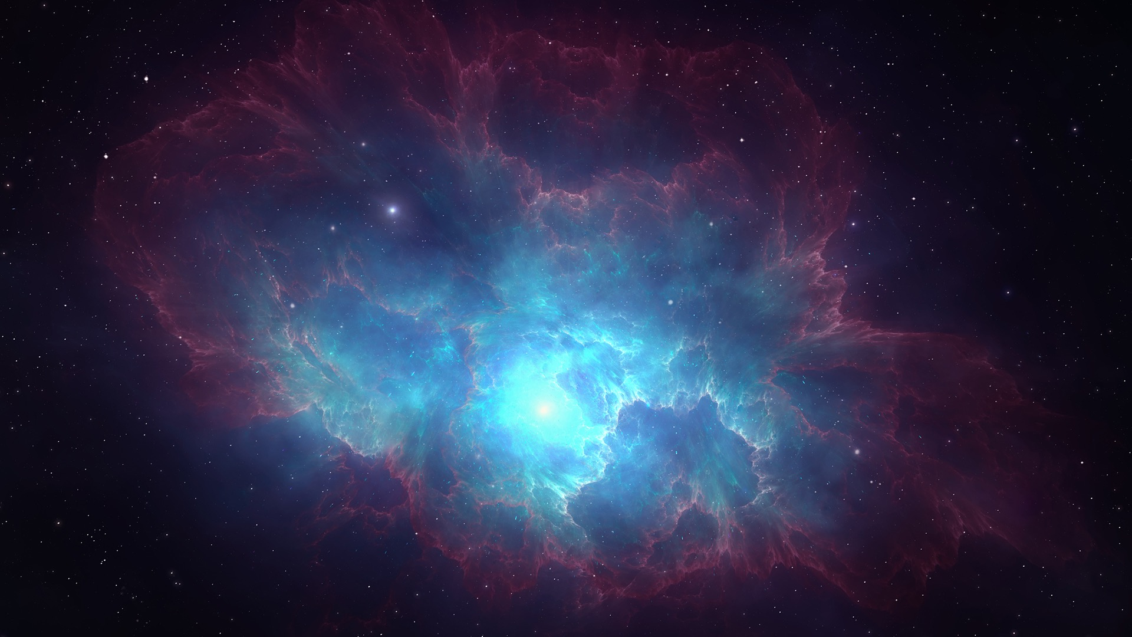
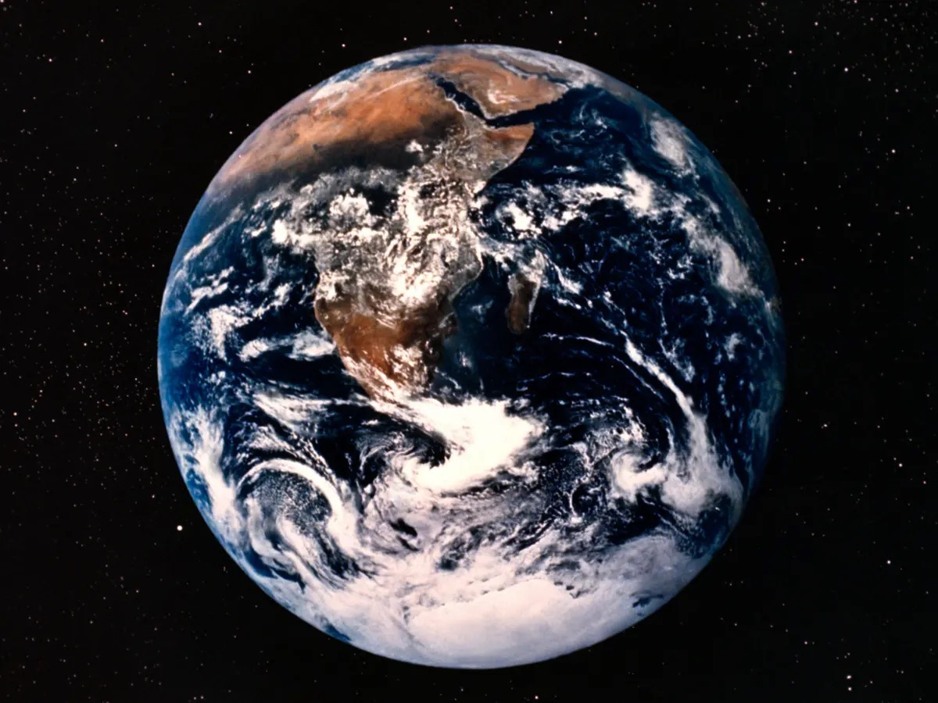

Slide 7
1 Peter 1:12
“…those who preached the gospel to you by the Holy Spirit sent from Heaven – things which angels desire to look into.”
to you

Slide 8
Ephesians 3:10,11
“…the manifold wisdom of God might be known by the church to the principalities and powers in the heavenly places, according to the eternal purpose which He accomplished in Christ Jesus our Lord.”

Slide 9
Revelation 4
Throne room
Glory
Honor
Power

Slide 10
Revelation 4, 5
Throne room Lamb slain
Glory Power
Honor Riches
Power Wisdom
Strength
Honor
Glory
Blessing

Slide 11
Revelation 4, 5
Throne room Lamb slain
Glory Power
Honor Riches
Power Wisdom
Strength
Honor
Glory
Blessing

