Slide 1
The Family of Man
MAN WOMAN

Slide 2
MAN
Lover
Leader
Provider
Protector

Slide 3
MAN WOMAN
Lover Helper
Leader
Provider
Protector

Slide 4
Genesis 2:18 - “helpmeet”
(Hebrew) – Ezer = one who helps
Helper comparable – NKJV
Helper fit - ESV

Slide 5
MAN WOMAN
Lover Helper
Leader
Provider
Protector

Slide 6
MAN WOMAN
Lover Helper
Leader Loves her family Provider
Protector

Slide 7
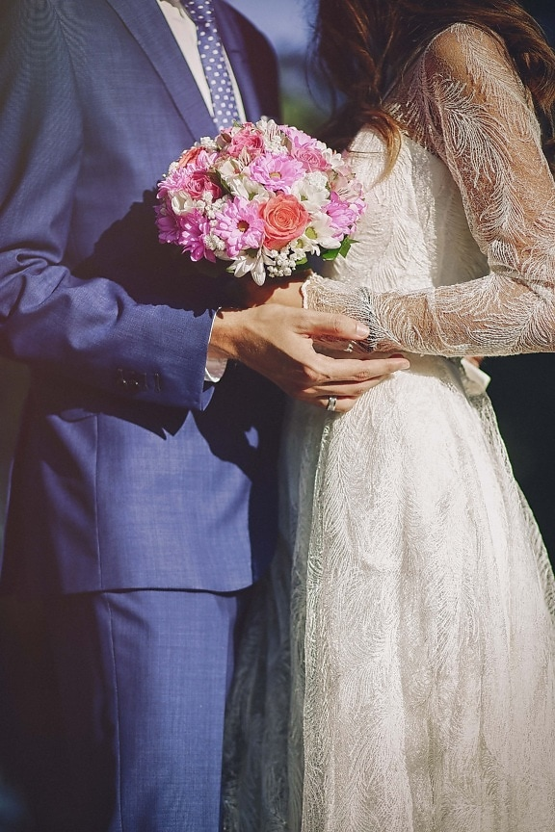
Titus 2:4,5
Love their husbands
Love their children
To be discreet
Chaste
Home-makers
Good
Obedient to their husbands

Slide 8
MAN WOMAN
Lover Helper
Leader Loves her family Provider Chaste/Discreet
Protector

Slide 9
Tertullian (Gk teacher) comments on Christian women’s
clothing as indicating their new spiritual worthiness:
“They no longer needed the former splendor of outward adornment, because clothed with the beauty and simplicity of Christlike character, they exchanged the temples, theaters and festivals of paganism for the home, labored with their hands, cared for their husbands and children, graciously dispensed Christian hospitality, nourished their spiritual life in the worship service…and
loving ministries to the sick.

Slide 10
…Their modesty and simplicity were a rebuke to and reaction from the shameless extravagances and immoralities of heathenism. That they were among the most conspicuous examples of the transforming powers of Christianity is manifest from the admiration and astonishment of the pagan Libanius who exclaimed,
“What women these Christians have!”

Slide 11
MAN WOMAN
Lover Helper
Leader Loves her family Provider Chaste/Discreet
Protector Makes home

Slide 12
MAN WOMAN
Lover Helper
Leader Loves her family Provider Chaste/Discreet
Protector Makes home
Submits husband

Slide 13
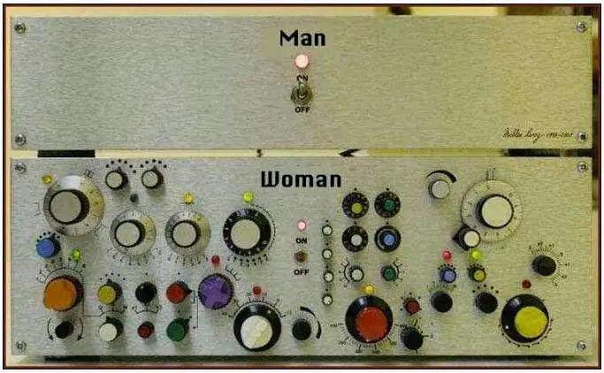
Man
ON
OFF
Woman

